Slide 1
Natural Language Processing
Lecture 2 of 2
UFCFUR-15-3
Advanced Artificial Intelligence

Slide 2
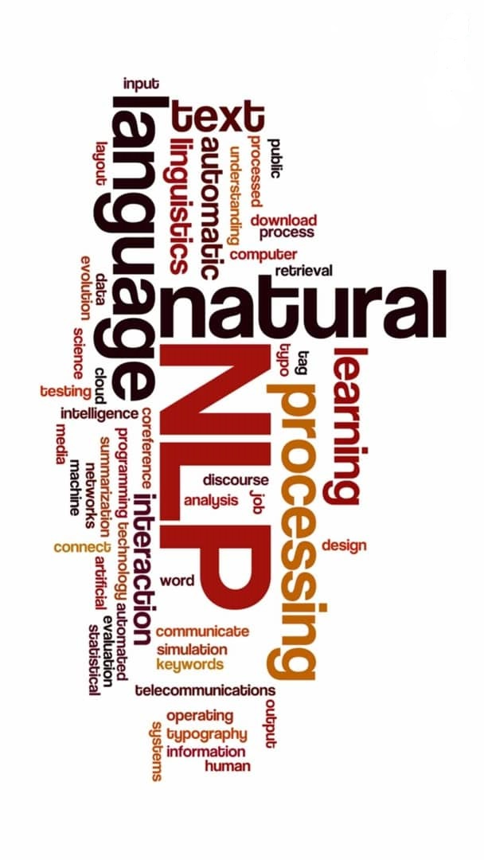
Part 1
Representing Sequences
Recurrent Neural Networks
Backprop through time
LSTM and GRU
Architecture Choices
Bi-directionality
Stacking
Sequence Encoding
Sequence to Sequence
Sequence Classification

Slide 3

Recurrent Neural Networks
Recap
Notes:
Abstract:
Natural language is highly complex. A word may have different meanings depending on its context and subtle grammatical differences may utterly change the meaning of a sentence. Yet, in computing terms, language representation is often nothing more than a string of characters - a sequence of bytes - which are not able to express the rich and complex syntax and semantics of human languages.
New Natural Language Processing (NLP) and Deep Learning techniques are able to generate representations of words, sentences or documents, which do capture their meaning. Word embedding’s, can model the similarity and relationship between words and sentences, and larger language models, such as BERT, ELMo and GP2, facilitate Natural Language Understanding (NLG) tasks and may even be used to generate text.
We will explore how these techniques and deep learning architectures work and how they have been successfully applied to many classic NLP tasks such as language translation, question answering, text classification and language generation.

Slide 4

Representing Sequences
Just as characters compose to form words, words compose to form sentences/sequences.
Just as words are different length, so are sentences, so we have a similar problem.
How to encode a sentence in a fixed length vector (list of numbers) representation?
But, the order of the words in a sentence determines its meaning, so we need to also consider the position of the words.
Feed forward ANN process each input feature in parallel, so position is lost.
The cat killed the dog.
The dog killed the cat.

Slide 5
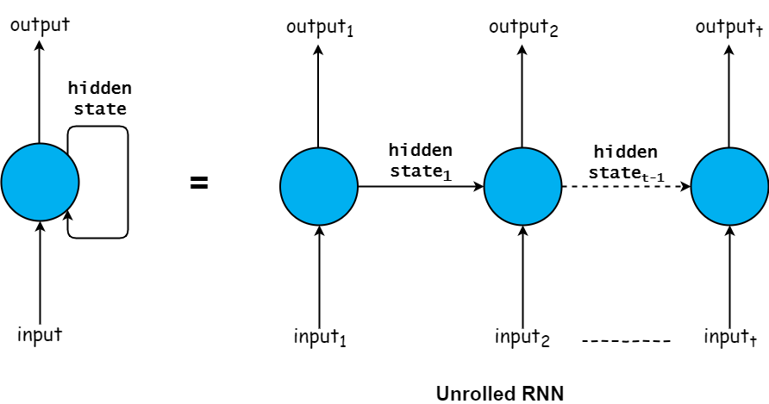
Recurrent Neural Networks (RNN)
Neural Network for data with a temporal relationship i.e. sequences of data where the past (or future) data might influence the present. ⁽¹⁾
RNN share an internal ‘hidden-state’ across all inputs. Effectively a network with memory of what it has previously seen.
Pearlmutter, B.A. (1989) Learning State Space Trajectories in Recurrent Neural Networks. Neural Computation [online]. 1 pp. 263–269. Available from: https://www.mitpressjournals.org/doi/pdfplus/10.1162/neco.1989.1.2.263.

Slide 6
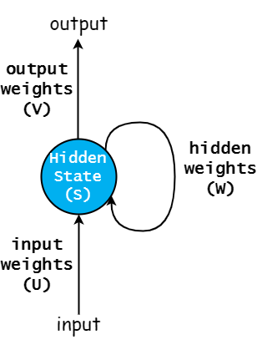
RNN - Memory
The hidden-state and weights are shared/updated across all timesteps of the input sequence.
Hidden-state is a vector representation of the sequence up to the current input.
Hidden state = $tanh(Ux_{t}+Ws_{t−1})$
Output = $softmax(Vs_{t})$
The output could be the final hidden-state i.e. a vector.
Or output could be the all hidden-states i.e. a matrix.

Slide 7
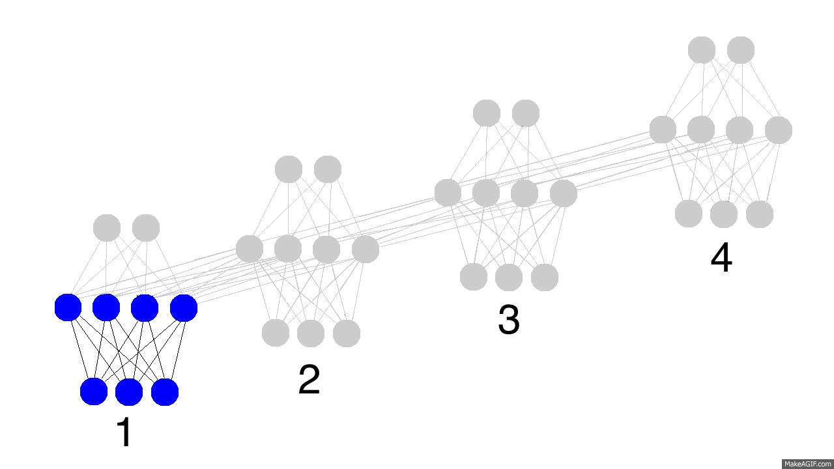
RNN - Memory
Over time the hidden-state ‘encodes’ information about each input from the sequence.
Though this does lead to a problem…what would happen in step 5?
Over many time-steps the gradients for backpropagating the error become smaller and smaller – the ‘vanishing gradient’ problem.
What about backpropagation?

Slide 8
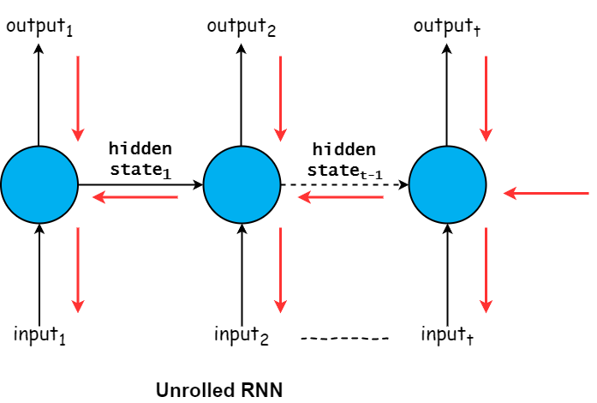
Backpropagation Through Time
Just like feed forward ANN, for RNN the weights must be updated with respect to the error/loss.
For RNN this is achieved with the Backpropagation Through Time (BPTT) algorithm.
The network is ‘unrolled’ and gradients are accumulated for each timestep. Then the network is ‘rolled-up’ and weights are updated.
Very long sequences result in increasingly small (vanishing) gradients.
$$\frac{{\text{∂}\text{E}}_{\text{1}}}{{\text{∂}\text{V}}_{\text{1}}}$$
$$\frac{{\text{∂}\text{E}}_{\text{2}}}{{\text{∂}\text{V}}_{\text{2}}}$$
$$\frac{{\text{∂}\text{E}}_{\text{t}}}{{\text{∂}\text{V}}_{\text{t}}}$$
$$\frac{{\text{∂}\text{W}}_{\text{2}}}{{\text{∂}\text{W}}_{\text{1}}}$$
$$\frac{{\text{∂}\text{W}}_{\text{2+1}}}{{\text{∂}\text{W}}_{\text{2}}}$$
$$\frac{{\text{∂}\text{W}}_{\text{t}\text{+1}}}{{\text{∂}\text{W}}_{\text{t}}}$$
$$\frac{{\text{∂}\text{U}}_{\text{1}}}{{\text{∂}\text{X}}_{\text{1}}}$$
$$\frac{{\text{∂}\text{U}}_{\text{2}}}{{\text{∂}\text{X}}_{\text{2}}}$$
$$\frac{{\text{∂}\text{U}}_{\text{t}}}{{\text{∂}\text{X}}_{\text{t}}}$$

Slide 9
Backpropagation Through Time
At each timestep the gradient is calculated for:
Error (E) with respect to the output weights (V).
Previous hidden state (W_{t-1}) with respect to current hidden state (W_{t}).
Input weights (U) with respect to input (X).
Gradients are accumulated and weights updated.
$$\frac{{\text{∂}\text{E}}_{\text{1}}}{{\text{∂}\text{V}}_{\text{1}}}$$
$$\frac{{\text{∂}\text{E}}_{\text{2}}}{{\text{∂}\text{V}}_{\text{2}}}$$
$$\frac{{\text{∂}\text{E}}_{\text{t}}}{{\text{∂}\text{V}}_{\text{t}}}$$
$$\frac{{\text{∂}\text{W}}_{\text{2}}}{{\text{∂}\text{W}}_{\text{1}}}$$
$$\frac{{\text{∂}\text{W}}_{\text{2+1}}}{{\text{∂}\text{W}}_{\text{2}}}$$
$$\frac{{\text{∂}\text{W}}_{\text{t}\text{+1}}}{{\text{∂}\text{W}}_{\text{t}}}$$
$$\frac{{\text{∂}\text{U}}_{\text{1}}}{{\text{∂}\text{X}}_{\text{1}}}$$
$$\frac{{\text{∂}\text{U}}_{\text{2}}}{{\text{∂}\text{X}}_{\text{2}}}$$
$$\frac{{\text{∂}\text{U}}_{\text{t}}}{{\text{∂}\text{X}}_{\text{t}}}$$

Slide 10
Truncated BPTT
Truncated Backpropagation Through Time (TBPTT) is a modified version of BPTT.
Periodically, every K1 timesteps, the BPTT algorithm is performed for only a fixed number (K2) number of timesteps.
For example, a sequence of 100 length can be split into 5 sequences of 20 and BPTT performed on each separately.
More efficient for long sequences and may mitigate vanishing gradients.
May miss long-term dependencies.
$$\frac{{\text{∂}\text{E}}_{\text{1}}}{{\text{∂}\text{V}}_{\text{1}}}$$
$$\frac{{\text{∂}\text{E}}_{\text{2}}}{{\text{∂}\text{V}}_{\text{2}}}$$
$$\frac{{\text{∂}\text{E}}_{\text{t}}}{{\text{∂}\text{V}}_{\text{t}}}$$
$$\frac{{\text{∂}\text{W}}_{\text{2}}}{{\text{∂}\text{W}}_{\text{1}}}$$
$$\frac{{\text{∂}\text{W}}_{\text{2+1}}}{{\text{∂}\text{W}}_{\text{2}}}$$
$$\frac{{\text{∂}\text{W}}_{\text{t}\text{+1}}}{{\text{∂}\text{W}}_{\text{t}}}$$
$$\frac{{\text{∂}\text{U}}_{\text{1}}}{{\text{∂}\text{X}}_{\text{1}}}$$
$$\frac{{\text{∂}\text{U}}_{\text{2}}}{{\text{∂}\text{X}}_{\text{2}}}$$
$$\frac{{\text{∂}\text{U}}_{\text{t}}}{{\text{∂}\text{X}}_{\text{t}}}$$

Slide 11
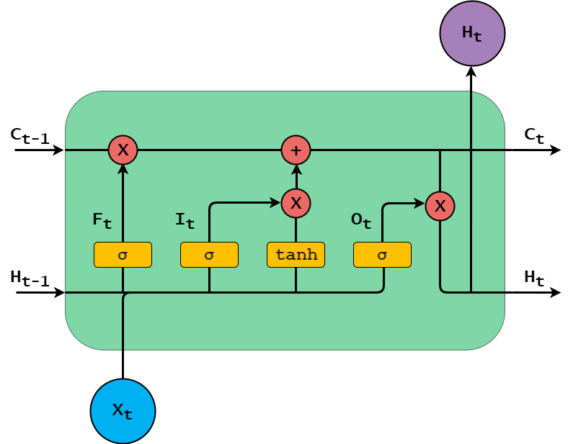
Long Short-term Memory (LSTM)
A type of RNN, with an additional cell-state (C).
LSTM also have ‘gates’ – internal feed forward networks – which allow them to learn what information to keep/discard.
Forget (F) – what to remove from the cell-state.
Input (I) – what to add to the cell-state.
Output (O) – what to output based on hidden-state and input.
Hochreiter, S., & Schmidhuber, J. (1997). Long Short-Term Memory. Neural Computation, 9(8), 1735–1780.
http://colah.github.io/posts/2015-08-Understanding-LSTMs

Slide 12
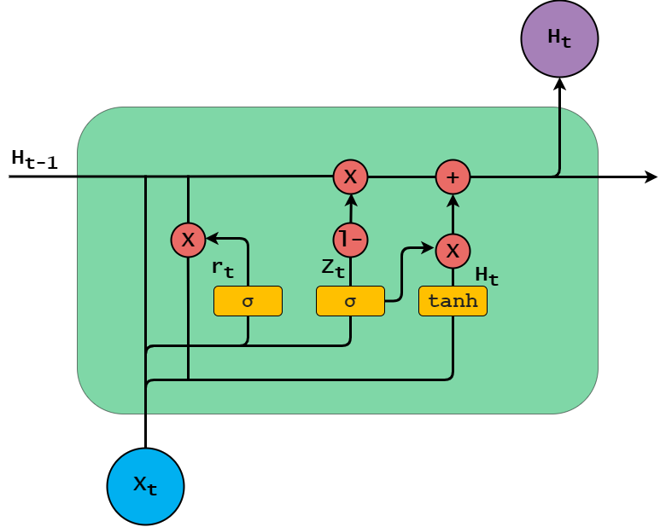
Gated Recurrent Unit (GRU)
A type of RNN, with only a hidden-state (H).
GRU have fewer gates than LSTM and are therefore less resource intensive – perhaps at the expense of long-term information.
Update (Z) – what historical information to keep within the hidden state.
Reset (R) – what historical information to forget.
Current (H) – what to output based on previous hidden-state, reset gate and input.
Chung, J., Gulcehre, C., Cho, K., & Bengio, Y. (2014). Empirical Evaluation of Gated Recurrent Neural Networks on Sequence Modeling. In NIPS 2014 Deep Learning and Representation Learning Workshop.

Slide 13
Architecture Choices
Typically RNN, and the variants, process sequences in the forwards direction. Time series data from past to present, a sentence from left to right.
However, it is possible to gain additional relational information from processing the sequence in reverse.
Additionally, we can stack RNN layers, like a standard feed forward ANN, taking the output of one as the input for another.

Slide 14
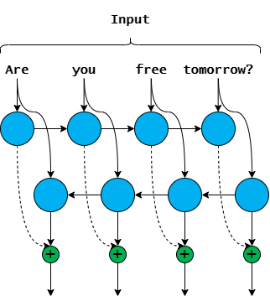
Bi-directional RNN
This can be achieved using Bi-directional RNN. Two layers which process the sequence in the forwards and backwards direction respectively.
The outputs of each layer are then concatenated to produce the output at each timestep.
More resource intensive than uni-directional RNN. But better able to capture contextual relationships.

Slide 15
Bi-directional RNN
By processing sequences of inputs RNN are able to capture sequential or temporal relationships between each timestep.
However, in some cases it may be beneficial to observe context, or the relationship between, the current input and previous words, as well as future words.
Future context may be important for word alignment e.g. translation tasks, and also for language modelling, where the network is tasked to predict missing words within a sequence (like word embeddings).
Schuster, M. and Paliwal, K.K. (1997) Bidirectional recurrent neural networks. IEEE Transactions on Signal Processing.

Slide 16
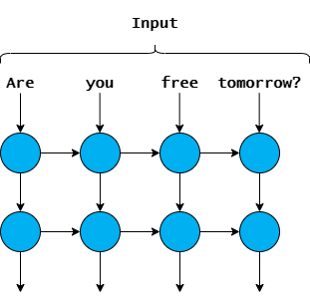
Stacked RNN
In a Deep RNN network the first layer processes the inputs and produces an output at each timestep.
The outputs of the first layer become the inputs for the intermediate layer, and so on.
Each subsequent layer learns increasingly fine-grained representations of the input sequence, or dependencies between timesteps.
Final output is each timestep (with pooling) or final hidden state of last RNN layer.

Slide 17
Stacked RNN
Just as Deep Feed Forward ANN consist of multiple layers, it is also possible to ‘stack’ RNN layers to produce Deep RNN.
Intention is the same; each layer will learn different aspects of the problem at different levels of abstraction.
For example, ELMo, a bi-directional multi-layer language model. The first layer learned semantic representations and the second language syntax.

Slide 18
Sequence Encoding
Conceptually similar to word embeddings.
Take a sequence of input words and create a fixed length vector representation i.e. convert them to a vector of real numbers.
Fixed length, because we want each sequence representation to be the same size, for downstream tasks e.g. classification.
Encoding should capture some positional and semantic features of the input sequence.

Slide 19
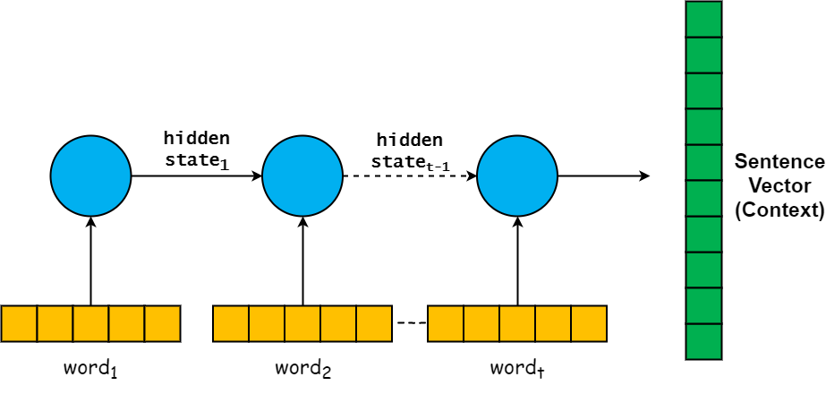
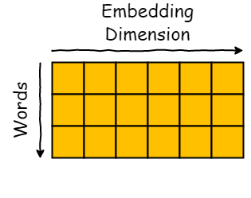
Sentence Encoding
For each input example an RNN processes the features in sequence. This could be integer representations, or word embeddings! So, an input sequence becomes a matrix (2D array/Tensor) of size max_sequence_length x embedding_dimension.
At each time-step the RNN cell process the word/embedding/feature, and updates the hidden state.

Slide 20
Sentence Encoding
Encoding sentences with LSTM/RNN update the hidden state at each time-step (word).
Can either;
Consider last hidden state as the sentence vector, also called context vector.
Or, output hidden state at each time-step, resulting in a matrix. Need to do some dimensionality reduction, i.e. pooling.
You can also use Convolutional Networks to encode sentences.

Slide 21
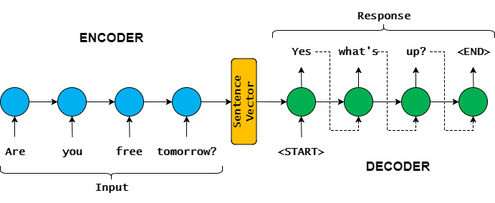
Sequence-to-Sequence (Seq2seq)
Encoder-decoder model is commonly used for text generation and prediction e.g. next sentence, word, or neural machine translation.
Encoder - final hidden-state is considered an encoded representation of the sentence, or the context vector.
Decoder - starts with the context vector as its hidden-state and generates the tokens.

Slide 22
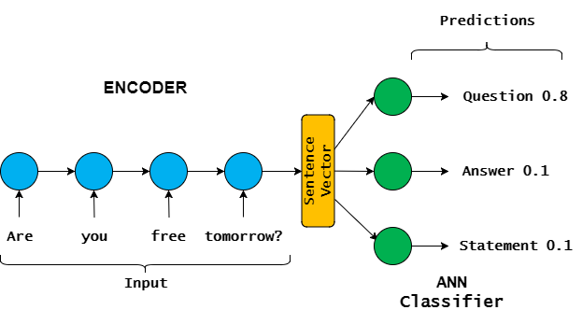
Sequence Classification
Can use similar approach to label sequences of text.
Could be dialogue act (question, answer, etc), topic, or sentiment.
Encoder - final hidden-state is considered an encoded representation of the sentence
Classifier - standard neural network takes encoded sentence as input and predicts the label

Slide 23
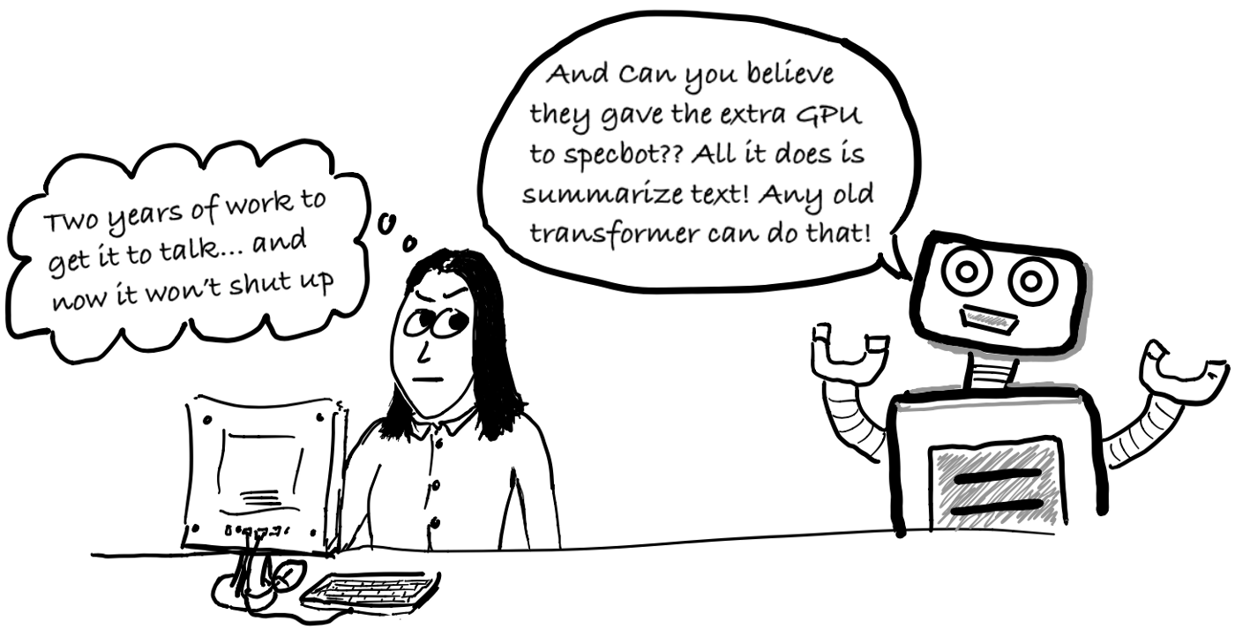
Part 2: Language Modelling
Language Models
N-gram
RNN
Sampling
Language Generation
Perplexity
Contextual Language Models
ELMo

Slide 24
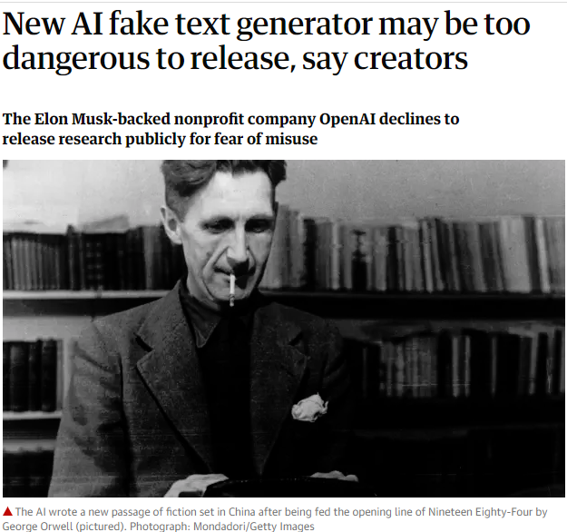
Language Modelling
Building general long-term model of language by learning to predict the next word(s) based on previous input.
Transferable to lots of natural language tasks:
Generating text – chatbots, ‘fake news’, etc…
Predicting text - what is the next word in the sentence? e.g. predictive text/spell checker!
Classifying text - is this a question or a statement?
Machine Translation.
Notes:
Open AI’s new language model!
Spell checking/predictive text

Slide 25
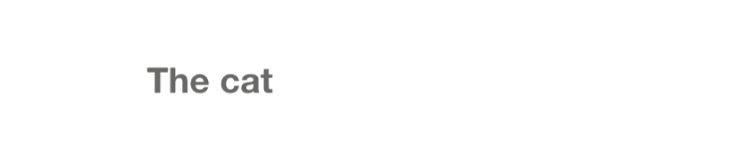
Language Modelling
Basic idea – assign a probability to a sequence of words from a vocabulary.
A language model computes either:
The probability of a sentence or sequence of words. $\text{P}\left(\text{s}\right) \text{=} \text{P}\text{(}{\text{w}}_{\text{1}}\text{,} {\text{w}}_{\text{2}}\text{,}\text{… }{\text{w}}_{\text{n}}\text{)}$
Can tell us if the sentence is grammatically correct, or likely e.g. translation.
Or, the probability of the next word, given a sequence of words. $\text{P}\text{(}{\text{w}}_{\text{n}}\text{|}{\text{w}}_{\text{1}}\text{,…, }{\text{w}}_{\text{n}\text{−1}}\text{)}$
To generate language.
p(The coffee black me pleases much) < p(I love dark coffee).
Eisenstein, J. (2018) Natural Language Processing Ch. 6.1
Notes:
Open AI’s new language model!
Spell checking/predictive text

Slide 26
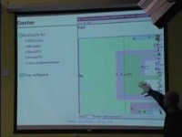
Early model with simple Bayesian models
Dasher was designed by the Inference group at Cambridge and has had lots of success as an accessible text input system

Slide 27
N-gram Language Model
$$\text{P}\left(\text{s}\right) \text{=} \text{P}\text{(}{\text{w}}_{\text{1}}\text{,} {\text{w}}_{\text{2}}\text{,}\text{… }{\text{w}}_{\text{n}}\text{)}$$
$$\text{P}\left(\text{s}\right) \text{=} \prod_{\text{n}}{\text{P}\text{(}{\text{w}}_{\text{n}}\text{|}{\text{w}}_{\text{1}}\text{,} {\text{w}}_{\text{2}}\text{,}\text{… }{\text{w}}_{\text{n}\text{−1}}\text{)}}$$
$$\text{P}\left(\text{s}\right)\text{ = }\text{P}\left({\text{w}}_{\text{1}}\right)\text{×} \text{P}\left({\text{w}}_{\text{2}}\text{|}{\text{w}}_{\text{1}}\right)\text{×}\text{ … }\text{×} \text{P}\text{(}{\text{w}}_{\text{n}}\text{|}{\text{w}}_{\text{1}}\text{,…, }{\text{w}}_{\text{n}\text{−1}}\text{)}$$
Probability of “I like cats”?
$$\text{P}\left(\text{′}\text{I} \text{like} \text{cats}\text{′}\right)\text{ = }\text{P}\left(\text{′}\text{I}\text{′}\right) \text{×} \text{P}\left(\text{′}\text{like}\text{′|′}\text{I}\text{′}\right) \text{×} \text{P}\left(\text{′}\text{cats}\text{′|′}\text{I} \text{like}\text{′}\right)$$
We can use n-grams to build simple language models, which calculate the probability of a sequence (s) of words (w) as the product of sub-sequences.
Using the chain rule we can compute the joint probability of words in a sentence.
However, in practice this is intractable:
Long sequences result in multiplying many, potentially small, probabilities.
It is unlikely all sequences will be represented in training corpus, so probabilities will be very small, or zero.
Eisenstein, J. (2018) Natural Language Processing Ch. 6.1

Slide 28
N-gram Language Model
Probability of “I like cats”?
$$\text{P}\left(\text{′}\text{I} \text{like} \text{cats}\text{′}\right)\text{ = }\text{P}\left(\text{′}\text{I}\text{′}\right) \text{×} \text{P}\left(\text{′}\text{like}\text{′|′}\text{I}\text{′}\right) \text{×} \text{P}\left(\text{′}\text{cats}\text{′|′}\text{I} \text{like}\text{′}\right)$$
Becomes
$$\text{P}\left(\text{′}\text{I} \text{like} \text{cats}\text{′}\right)\text{ = }\text{P}\left(\text{′}\text{I}\text{′}\right) \text{×} \text{P}\left(\text{′}\text{like}\text{′|′}\text{I}\text{′}\right) \text{×} \text{P}\left(\text{′}\text{cats}\text{′|′}\text{like}\text{′}\right)$$
Instead we can simplify, using the Markov assumption. That is, estimate the probabilities of each component, conditioned only on the previous word (bi-gram), or words (tri-gram+).
So, $\text{P}\text{(}{\text{w}}_{\text{n}}\text{|}{\text{w}}_{\text{1}}\text{,…, }{\text{w}}_{\text{n}\text{−1}}\text{) }\text{≈} \text{P}\text{(}{\text{w}}_{\text{n}}\text{|}{\text{w}}_{\text{n}\text{−1}}\text{)}$
In other words, we can iteratively build up the probability of a sequence by multiplying the probability of each word appearing, given the context word(s).
Eisenstein, J. (2018) Natural Language Processing Ch. 6.1

Slide 29
N-gram Language Model
['This is a dog', 'This is a cat', 'I love my cat', 'I love my dog', 'This is my name’]
$$\text{P}\text{(′}\text{is}\text{′|′}\text{this}\text{′)=}\frac{\text{P}\text{(′}\text{this}\text{′,′}\text{is}\text{′)}}{\text{P}\text{(′}\text{this}\text{′)}}\text{=}\frac{\text{3}}{\text{3}}$$
$$\text{P}\text{(′}\text{my}\text{′|′}\text{is}\text{′)=}\frac{\text{P}\text{(′}\text{is}\text{′,′}\text{my}\text{′)}}{\text{P}\text{(′}\text{is}\text{′)}}\text{=}\frac{\text{1}}{\text{3}}$$
$$\text{P}\text{(′}\text{dog}\text{′|′}\text{my}\text{′)=}\frac{\text{P}\text{(′}\text{my}\text{′,′}\text{dog}\text{′)}}{\text{P}\text{(′}\text{my}\text{′)}}\text{=}\frac{\text{1}}{\text{3}}$$
We can estimate the probabilities using Maximum Likelihood. For bi-grams this is simply:
$$\text{P}\text{(}{\text{w}}_{\text{n}}\text{|}{\text{w}}_{\text{n}\text{−1}}\text{)=}\frac{\text{count}\text{(}{\text{w}}_{\text{n}\text{−1}}\text{, }{\text{w}}_{\text{n}}\text{)}}{\text{count}\text{(}{\text{w}}_{\text{n}\text{−1}}\text{)}}$$
So the probability of ‘This is my dog’, given the corpus is:
$$\text{P}\text{(′}\text{is}\text{′|′}\text{this}\text{′)}\text{×}\text{P}\text{(′}\text{my}\text{′|′}\text{is}\text{′)}\text{×}\text{P}\text{(′}\text{dog}\text{′|′}\text{my}\text{′) = }$$
$\text{1}\text{×}\frac{\text{1}}{\text{3}}\text{×}\frac{\text{1}}{\text{3}}$ = 0.112
Eisenstein, J. (2018) Natural Language Processing Ch. 6.1

Slide 30
N-grams and Language Modelling
Language generation is a similar formulation of the problem. Given a sequence of words, what is the next most likely word (of all words in the vocabulary)?
Start with a ‘seed’ phrase or token. Can be a start of sentence token (<s>) or word(s).
Select, or sample, from all possible next tokens, given the current text.
Add generated token to text.
Repeat from 2.
['<s> I am Sam </s>', '<s> Sam I am </s>', '<s> I do not like green eggs and ham </s>’]
Seed Text: ‘<s>’
'i': 0.667, 'sam': 0.334
Text: ‘<s> i’
'am': 0.667, 'do': 0.334
Text: ‘<s> i am’
'sam': 0.5, '</s>': 0.5
Text: ‘<s> i am sam’
‘</s>': 0.5, ‘i': 0.5
Text: ‘<s> i am sam </s>’

Slide 31
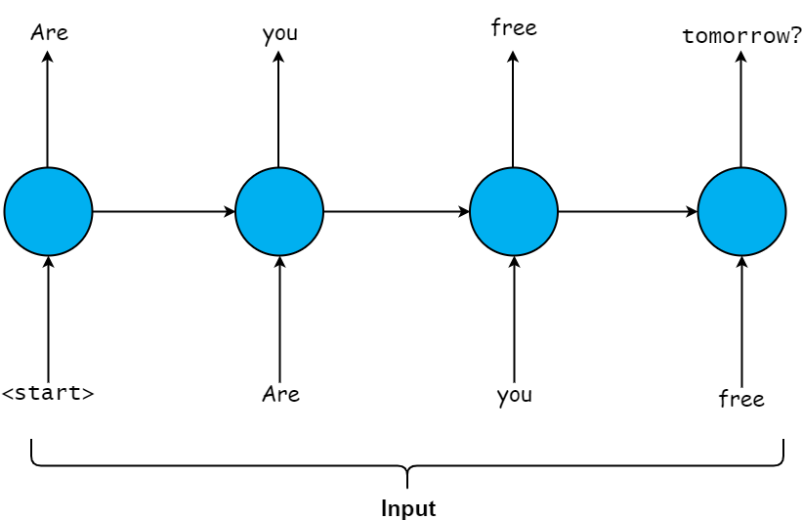
Recurrent Language Modelling
The n-gram language models are limited and can be ‘brittle’.
There is no guarantee that a particular n-gram will exist within the training corpus. So, such a language model would never be able to generate that combination of words.
Selection of n-gram(s) is difficult. Do you stick with bi-grams? Or combine bi-grams and tri-grams?
Naturally, RNN are well suited to modelling sequences.

Slide 32
Recurrent Language Modelling
Unsupervised training with a very large natural language data set, such as, Wikipedia, Amazon reviews, Google books, or anything really.
Input sequences into recurrent network and train to predict the next word or character in the sequence.
The learned weights can then be used as a starting point for all kinds of NLP tasks.
More Transfer Learning!

Slide 33
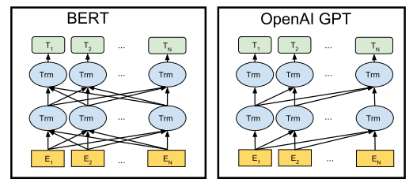

Types of Language Models
The ‘classic’ language modelling task is also known as an Autoregressive model. It is characterised by only being able to see what was before in the text, and not what’s after. Good for language generation (GPT).
Autoencoding models are trained by perturbing the inputs in some way and trying to construct the original sentence. For example, randomly masking (removing) tokens from the input. Good for fine tuning to other tasks (BERT).
Seq2seq, as we have seen, encode the input to a single vector which is then decoded into the output sequence. Good for translation (T5).

Slide 34
Sampling
When generating text, how do you select which token to append? Intuitively you might just select the token with the highest probability, a greedy approach.
However, even with sophisticated language models this can result in repetitive or incoherent text.
The most probable token is not necessarily correct.
One incorrect token and the model begins generating the wrong ‘path’.

Slide 35
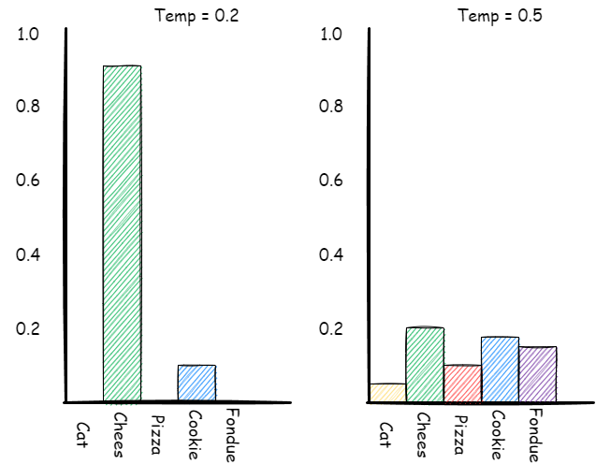
Sampling - Temperature
Temperature is an additional parameter used to increase or decrease the models confidence in the most likely next token.
Temperature is usually a value between 0 and 1. It modifies the probabilities of possible next tokens.
Low temperature ‘amplifies’ high probability tokens, so the model is more confident in choosing the most probable word.
High temperature evens out probabilities, so the model has more options to choose from and can be more creative.
https://lukesalamone.github.io/posts/what-is-temperature/.

Slide 36
Sampling - Temperature
More Transfer Learning:
But this time from the field of meta-heuristic optimization algorithms into ML ☺
Simulated Annealing is a single member search method that uses a temperature to make decisions about whether to accept a worsening move.
- Allows escape from local optima.
Kirkpatrick, S.; Gelatt Jr, C. D.; Vecchi, M. P. (1983). "Optimization by Simulated Annealing". Science. 220 (4598): 671–680.
https://lukesalamone.github.io/posts/what-is-temperature/.

Slide 37
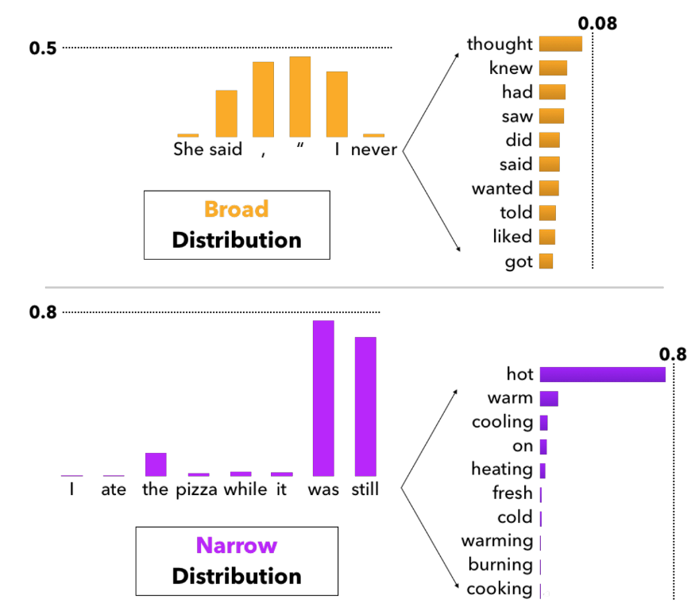
Sampling - Top-k
In top-k sampling we sort tokens by probabilities and then ignore anything below the k^{th} token.
In some cases there might be a broad distribution to choose from, and in others only a narrow selection of words is appropriate.
In Nucleus sampling, or top-p, we set a threshold of say p=0.9. Once the cumulative probability of tokens reaches p we ignore the rest. This preserves creativity while removing obviously incorrect ones.
Holtzman, A., Buys, J., Du, L., Forbes, M. and Choi, Y. (2019) The Curious Case of Neural Text Degeneration. In: ICLR 2020 [online].

Slide 38
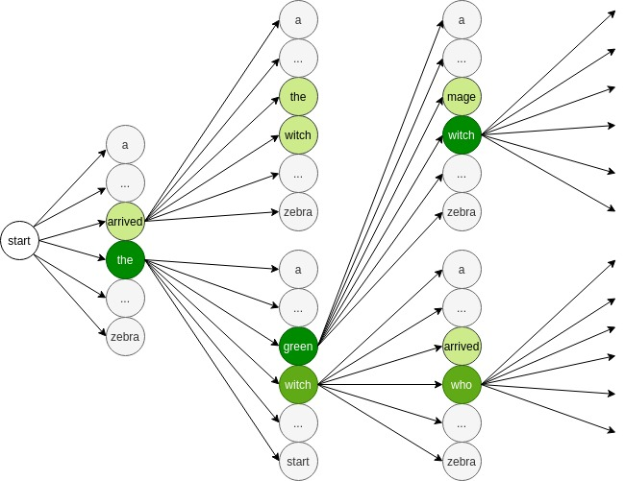
Sampling - Beam Search
Beam search allows the model to choose from alternative paths.
The beam width parameter determines the number (N) of paths to consider.
At each step we can consider N different tokens, given the current text.
Can also consider N alternative token sequences i.e. text can be generated in a branching fashion to build up multiple text sequences. Then choose the most probable.
https://www.width.ai/post/what-is-beam-search

Slide 39
Language Generation
Depending on training corpus, sampling and seed text, language models can generate all kinds of different texts.
OpenAI only provide access to their GPT-3 model through an API. Claiming that they are concerned about ethical implications e.g. using it to generate fake news/propaganda.
Of course, this also allows them to monetise access…

Slide 40
Language Generation
Some examples from Andrej Karpathy…
King Lear:
O, if you were a feeble sight, the courtesy of your law,
Your sight and several breath, will wear the gods
With his heads, and my hands are wonder'd at the deeds,
So drop upon your lordship's head, and your opinion
Shall be against your honour.
Baby Names:
Lessie, Rasemy, Guen, Gavi, Milea, Anneda, Margoris, Janin, Rodelin, Zeanna, Elyne, Janah, Ferzina, Susta, Pey, Castina
Doesn’t always work of course…
“Baby”, “Killie”, “Char”, “R”, “More”, “Mars”, “Hi”, “Saddie”, “With” and “Ahbort”
http://karpathy.github.io/2015/05/21/rnn-effectiveness/

Slide 41
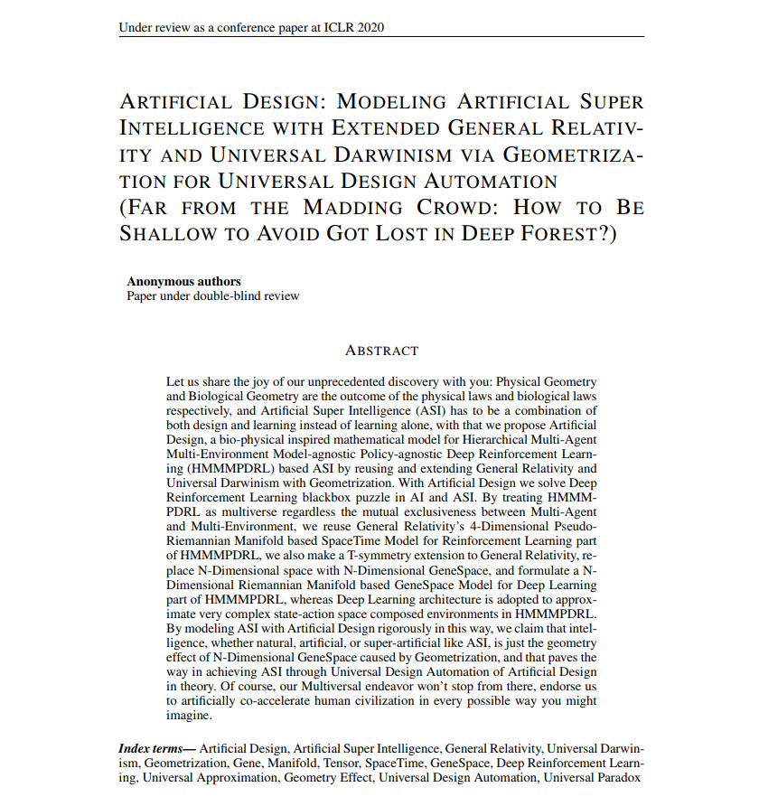
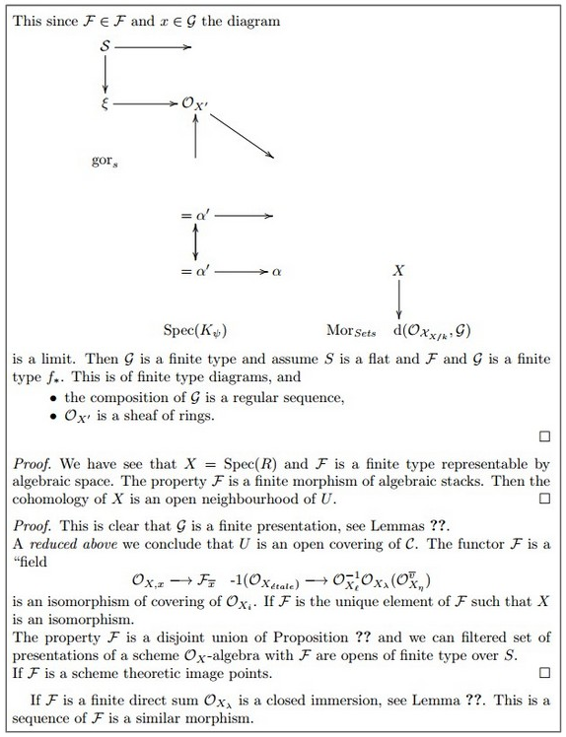
https://openreview.net/forum?id=SyxQ_TEFwS

Slide 42
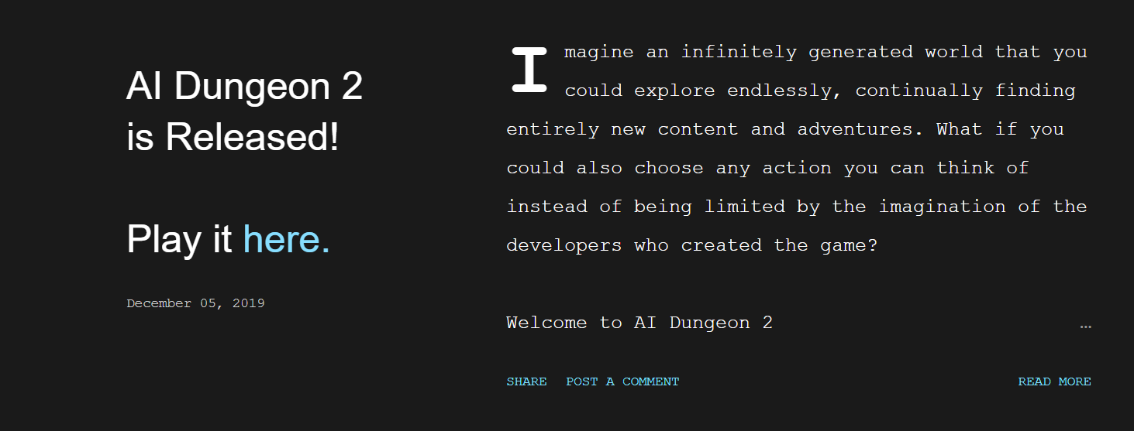
http://www.aidungeon.io/

Slide 43
https://www.aiagainsthumanity.app/

Slide 44
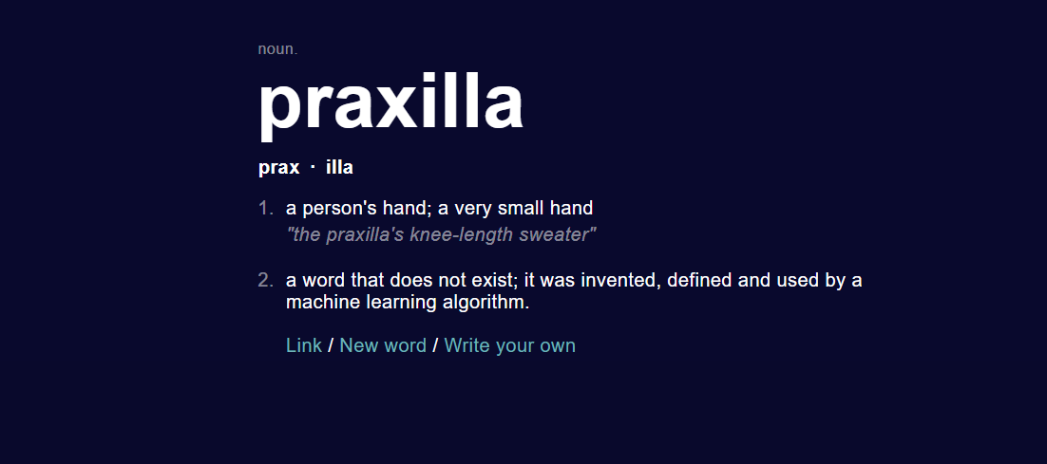
http://www.thisworddoesnotexist.com//

Slide 45
Perplexity
How to evaluate a language model? Accuracy doesn’t make much sense.
The vocabulary is a discrete set of words, but that means potentially thousands of classes.
Also, two valid, grammatically correct, sequences would result in different accuracy.
Can measure semantic similarity between generated text and some reference sentence. Or use metrics such as BLEU and METEOR, if exact match is required.

Slide 46
Perplexity
Perplexity can be considered a measure of a language models uncertainty when
predicting the next word ${\text{w}}_{\text{n}\text{+}\text{1}}$, given the previous words in the sequence $\text{(}{\text{w}}_{\text{1}}\text{,…, }{\text{w}}_{\text{n}}\text{)}$.
Perplexity is closely linked to the models entropy – the similarity between the distribution the model has learned from the training text Q, and the actual distribution P.
Perplexity does not inform us of the quality, nor topical relevance, of the generated utterance. However, it does provide us with a kind of ‘confidence’ value for the language model when generating responses.
Cross-entropy (loss)
$$\text{H}\left(\text{P}\text{, }\text{Q}\right)\text{=−}\sum_{\text{i}\text{=1}}^{\text{n}}{\text{P}\left({\text{w}}_{\text{i}}\right)\text{log}\text{Q}\text{(}{\text{w}}_{\text{i}}\text{)}}$$
Perplexity
$$\text{PPL}\left(\text{P}\text{,}\text{Q}\right)\text{= }{\text{2}}^{\text{H}\text{(}\text{P}\text{,}\text{Q}\text{)}}$$

Slide 47
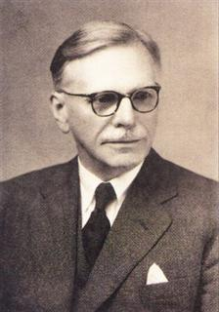
Contextual Language Models
The meaning of a word is often dependant on the context that it is used.
Traditional word embeddings produce the same fixed set of numbers (vector) regardless of the sentence we are trying to represent.
Polysemy – words with multiple meanings.
“I sat by the river bank.” or “I robbed the bank.”
Deixis – words that need contextual information.
“I enjoy living in this city.”
“You shall know a word by the company it keeps.”
(Firth, J. R. 1957)

Slide 48


ELMo!
Embeddings from Language Models (ELMo), developed at the Allen Institute for Artificial Intelligence in 2018⁽¹⁾.
ELMo started a trend of large pre-trained contextual language models that can later be fine-tuned for NLP tasks.
ELMo uses Multi-layer Bi-directional recurrent networks (BiLSTM).
This means for a given word we get its past and future context within a sentence.
Peters, M. E. et al. (2018) ‘Deep Contextualized Word Representations’, in NAACL 2018. Available at: http://allennlp.org/elmo (Accessed: 13 July 2018).

Slide 49

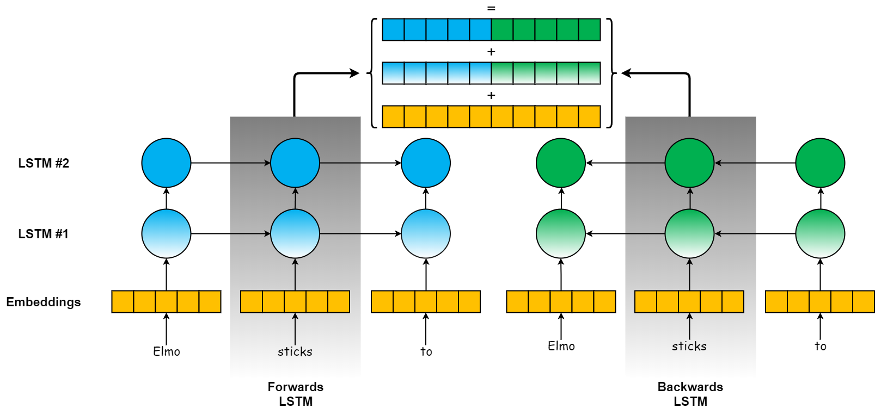
ELMo!
Peters, M. E. et al. (2018) ‘Deep Contextualized Word Representations’, in NAACL 2018.

Slide 50
ELMo!
Pre-training on a 1 Billion word corpus is expensive and time consuming.
Now we can ‘freeze’ the LSTM layers (i.e. not train them anymore) and generate contextual embeddings.
Layer-1 ‘learned’ semantics and;
Layer-2 syntax of language (e.g. POS).
ELMO achieved state of the art results on 6 different NLP tasks.
Even more Transfer Learning!
Task | Accuracy % (Increase )
Question Answering (SQuAD) | 85.8 (+24.9%)
Named Entity Recognition (CoNLL) | 92.2 (+21%)
Coreference Resolution (Coref) | 70.4 (+9.8%)
Sentiment Analysis (SST-5) | 54.7 (+6.8%)
Peters, M. E. et al. (2018) ‘Deep Contextualized Word Representations’, in NAACL 2018. Available at: http://allennlp.org/elmo (Accessed: 13 July 2018).
Notes:
Sentiment Analysis
Coreference Resolution (Anaphora)
Named Entity Recognition
Question Answering

Slide 51
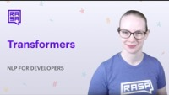
Good explainer … issues from 4:37

Slide 52
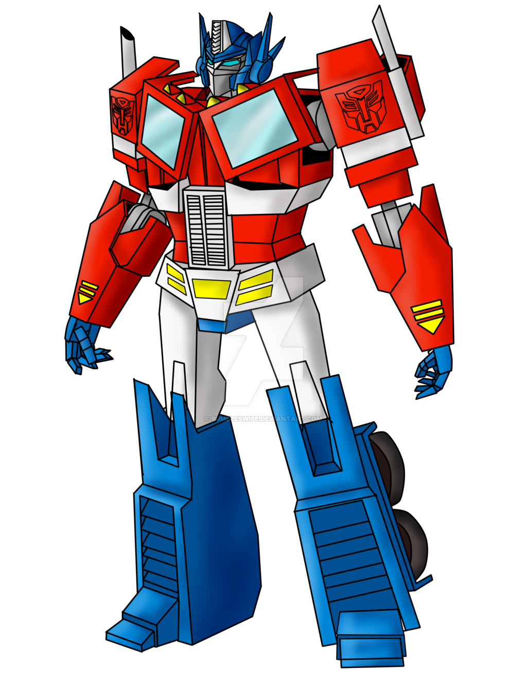
Part3: Attention and Transformers
Sequence-to-sequence (Seq2seq)
Attention Mechanisms
Self
Hard/Soft
Word-overlap Metrics
Transformers
BERT
GLUE and SQuAD

Slide 53
Sequence-to-Sequence (Seq2seq)
A typical RNN model has fixed-size input and output vectors. However, this is not always desirable.
Consider Machine Translation (MT). An English phrase may have more (or fewer) tokens than its French translation.
Similarly, for speech recognition, text summarisation or language generation we may need a different number of inputs and outputs.

Slide 54
Sequence-to-Sequence (Seq2Seq)
Seq2Seq or Encoder-decoder models help solve this problem by separating the input encoding and output decoding.
Encoder - final hidden-state is considered an encoded representation of the sequence, or the context vector.
Decoder - starts with the context vector as its hidden-state and generates the tokens.

Slide 55
Sequence-to-Sequence (Seq2Seq)
During training for a Seq2Seq model we often use a technique called Teacher Forcing.
Because tokens are generated sequentially, if the decoder makes a mistake it will be appended to the sequence and likely cause further incorrect predictions!
With Teacher Forcing, regardless of the predicted token, the correct token is appended to the sequence, forcing the model to make predictions for the actual input sequence.

Slide 56
Sequence-to-Sequence (Seq2seq)
Two problems with Seq2seq models lead to bottlenecks in performance:
Fixed-size context vector - due to a constant size, over very long sequences the model may ‘forget’ earlier timesteps.
Only one context vector - the decoder is only provided with the final hidden-state of the encoder. So it does not have access to the hidden-state at previous timesteps.

Slide 57
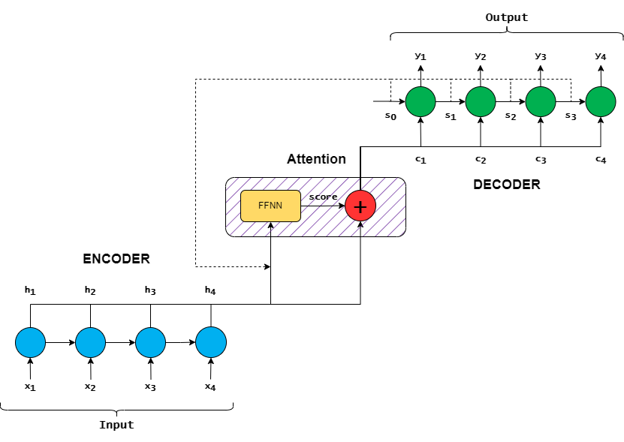
Attention Mechanisms
The attention mechanism aims to solve the highlighted issues with Seq2seq models.
Instead of encoding a single context vector, the model encodes the input sequence into a sequence of vectors.
The attention mechanism allows the decoder to ‘pay attention’ to the relevant inputs, depending on its hidden-states, and ignore less important ones.

Slide 58
Attention Mechanisms
The encoder processes the input sequence and outputs the hidden state at each timestep (h_{1-n}).
The encoder hidden states and the current decoder state (s₀) are input to the attention mechanism.
The attention mechanism applies a FFNN layer to the inputs to produce the attention score.
The attention score is concatenated with the encoder outputs to produce the context vector (c₁).
Bahdanau, D., Cho, K. and Bengio, Y. (2015) Neural Machine Translation by Jointly Learning to Align and Translate. In: ICLR 2015
Luong, M.T., Pham, H. and Manning, C.D. (2015) Effective Approaches to Attention-based Neural Machine Translation. In: EMNLP 2015

Slide 59
Attention Mechanisms
There are various approaches to calculating the attention score. However, the most common are additive⁽¹⁾ or multiplicative⁽²⁾.
Additive attention multiplies the hidden state (h) and decoder state (s) with a weight matrix W and then adds them together. The sum is then passed through a tanh activation function and multiplied by v, another weight matrix.
Multiplicative attention simply multiplies W with s and h.
Softmax is applied to the score and finally, the context vector for the current timestep is calculated.
Additive (Bahdanau style)
$$\text{score}\left({\text{h}}_{\text{t}}\text{, }{\text{s}}_{\text{t}\text{−1}}\right) \text{= }\text{v} \text{tanh}\text{(}{\text{W}}_{\text{1}}{\text{h}}_{\text{t}}\text{+}{\text{W}}_{\text{2}}{\text{s}}_{\text{t}\text{−1}}\text{)}$$
Multiplicative (Luong style)
$$\text{score}\left({\text{h}}_{\text{t}}\text{, }{\text{s}}_{\text{t}\text{−1}}\right) \text{= }{\text{h}}_{\text{t}}\text{W}{\text{s}}_{\text{t}\text{−1}}$$
Context Vector
$${\text{a}}_{\text{t}} \text{= }\text{softmax}\text{(}\text{score}\text{)}$$
$${\text{c}}_{\text{t}} \text{=}\sum_{\text{i}\text{=1}}^{\text{n}}{{\text{a}}_{\text{t}}{\text{h}}_{\text{t}}}$$
Bahdanau, D., Cho, K. and Bengio, Y. (2015) Neural Machine Translation by Jointly Learning to Align and Translate. In: ICLR 2015
Luong, M.T., Pham, H. and Manning, C.D. (2015) Effective Approaches to Attention-based Neural Machine Translation. In: EMNLP 2015: Conference on Empirical Methods in Natural Language Processing

Slide 60
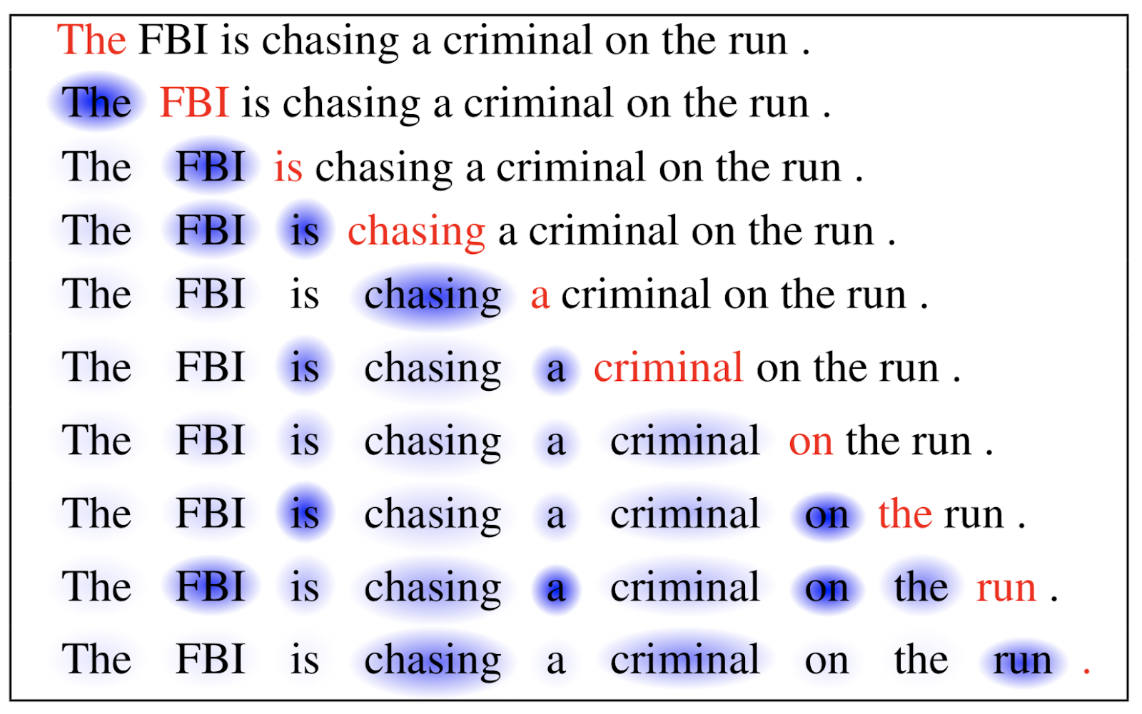
Attention Mechanisms
In addition to the different approaches for calculating the attention score there are several broader categories of attention mechanism.
Self-attention (intra-attention)⁽¹⁾ is widely used within NLP. It allows each token in the input sequence to ‘attend’ to tokens in different positions within the sequence.
Thus we can see how each word is related to the previous words in the sentence.
Very useful for MT, summarisation and so on.
Cheng, J., Dong, L. and Lapata, M. (2016) Long short-term memory-networks for machine reading. In: EMNLP 2016

Slide 61
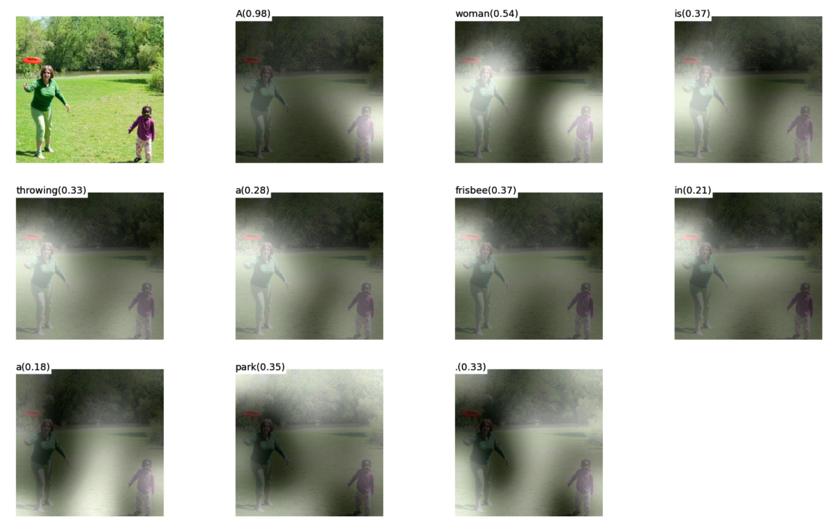
Attention Mechanisms
Soft attention places the attention weights ‘softly’ over the entire input sequence (or image). It discounts the irrelevant features and promotes useful ones. Effectively the same as additive attention.
Hard attention only focuses on a specific part of the input at any one time. This is faster but the model is non-differentiable, so requires complex techniques for updating the weights.
Hard attention can be used to generate captions for images, for example⁽¹⁾.
“A woman is throwing a frisbee in a park.”
Xu, K., Ba, J.L., et. Al. (2015) Show, Attend and Tell: Neural Image Caption Generation with Visual Attention. In: 32nd International Conference on Machine Learning, ICML 2015

Slide 62
Questions?
Aside – how do we measure good?

Slide 63
Word-overlap Metrics
For some language generation tasks, such as MT, we may wish to evaluate the quality of the generated text.
However, in MT we cannot expect perfect alignment between input and output sequences, or there may be a different number of tokens. Again accuracy is not appropriate here, nor is perplexity.
For this purpose a range of word-overlap (or alignment) metrics have been developed. They evaluate generated sentence(s) with respect to a reference sentence(s).
Reference:
‘The cat sat on the mat.’
Candidate/hypothesis:
‘On the mat sat the cat.’
‘On the cat sat the mat.’
Papineni, K., Roukos, S., et. al (2002) BLEU: a Method for Automatic Evaluation of Machine Translation. In: Proceedings of the 40th Annual Meeting of the Association for Computational Linguistics (ACL)
Banerjee, S. and Lavie, A. (2005) METEOR: An Automatic Metric for MT Evaluation with Improved Correlation with Human Judgments. In: ACL Workshop on Intrinsic and Extrinsic Evaluation Measures for Machine Translation and/or Summarization
Lin, C.Y. (2004) ROUGE: A Package for Automatic Evaluation of Summaries. In: In Proceedings of the Workshop on Text Summarization Branches Out

Slide 64
Word-overlap Metrics
BLEU compares the number of common n-grams, typically 1 to 4, over all the candidate and reference utterances in the corpus.
METEOR first calculates the alignment (exact matches, as well as stem, synonym, and paraphrase matches) between the candidate and the reference utterances by mapping each uni-gram in the candidate sentence to 0 or 1 uni-gram in the reference sentence.
ROUGE was proposed for the automatic evaluation of summaries. ROUGE-N calculates the n-gram co-occurrence, while ROUGE-L is based on the longest common sub-sequence.
Reference:
‘The cat sat on the mat.’
Candidate/hypothesis:
 | BLEU | METEOR
‘On the mat sat the cat.’ | 0.43 | 0.5
‘On the cat sat the mat.’ | 0.47 | 0.93
Papineni, K., Roukos, S., et. al (2002) BLEU: a Method for Automatic Evaluation of Machine Translation. In: Proceedings of the 40th Annual Meeting of the Association for Computational Linguistics (ACL)
Banerjee, S. and Lavie, A. (2005) METEOR: An Automatic Metric for MT Evaluation with Improved Correlation with Human Judgments. In: ACL Workshop on Intrinsic and Extrinsic Evaluation Measures for Machine Translation and/or Summarization
Lin, C.Y. (2004) ROUGE: A Package for Automatic Evaluation of Summaries. In: In Proceedings of the Workshop on Text Summarization Branches Out

Slide 65
Word-overlap Metrics
Each of these metrics produce a score between 0 and 1. For BLEU the following ranges are often used to interpret the score:
30-40 Good translations
40-50 High quality translations
50-60 Fluent translations
60> Possibly better than humans
However, there are some problems with BLEU⁽¹⁾, particularly when comparing scores between datasets, with a different number of reference sentences, or where different tokenisation has been performed. These can all affect the score!
Reference:
‘The cat sat on the mat.’
Candidate/hypothesis:
 | BLEU | METEOR
‘On the mat sat the cat.’ | 0.43 | 0.5
‘On the cat sat the mat.’ | 0.47 | 0.93
Post, M. (2018) A Call for Clarity in Reporting BLEU Scores. WMT 2018 - 3rd Conference on Machine Translation, Proceedings of the Conference

Slide 66
Back to the story …

Slide 67

Transformers and Attention
The problem with recurrent models:
They are recurrent…
Encoding long sequences.
For the 2nd problem the attention mechanism was proposed to allow the network to ‘pay attention’ (score) to the important words in a sequence.
For the 1st problem? Throw away the recurrence.
Attention is all you need! ⁽¹⁾ The Transformer architecture was introduced in 2017 by the Google Brain team.
Vaswani, A. et al. (2017) ‘Attention Is All You Need’, in 31st Conference on Neural Information Processing Systems (NIPS 2017). Long Beach, CA. doi: 10.1017/S0140525X16001837.

Slide 68
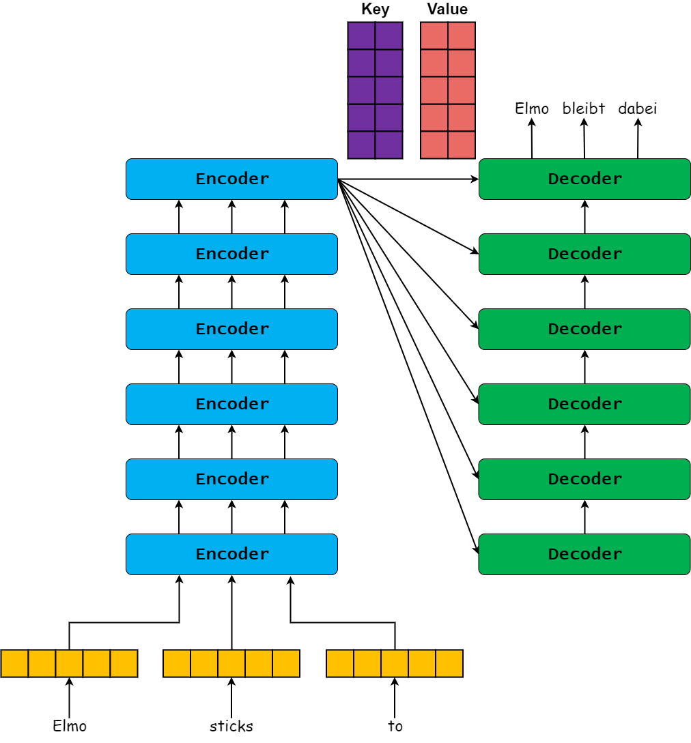
Transformers
Similar encoder-decoder process as recurrent models. With Transformers the entire sequence is processed in parallel, so faster computation.
Original paper had a stack of 6 ‘Self-attention ‘ encoders/decoders and 8 attention heads.
Encoders - create Key and Value matrices – effectively sentence matrices.
Decoders - decode each word at each time step using word-position encoding.
https://jalammar.github.io/illustrated-transformer/.

Slide 69

Transformers
https://jalammar.github.io/illustrated-transformer/.

Slide 70
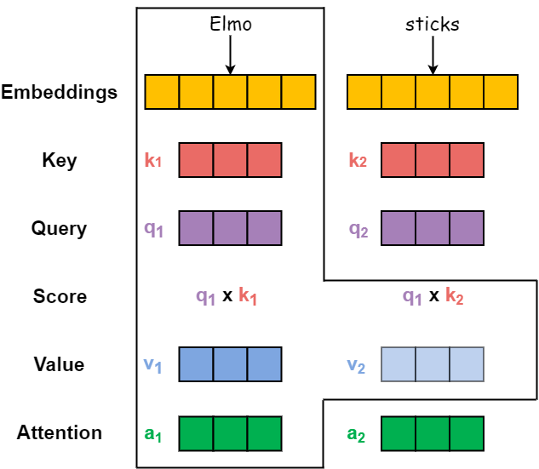
Transformer Self-attention
Create Key, Query and Value matrices (K,Q,V) – sets of learned weights.
For a given word:
Generate ‘scores’ - Q x K_{1-n}
Scores x V
Sum V = Words attention
Multiplying V by Score allows us to focus on important words and ignore unimportant.
Attention!
https://jalammar.github.io/illustrated-transformer/.

Slide 71
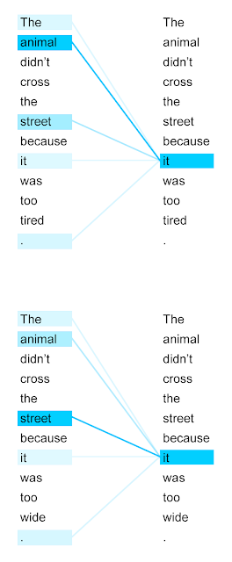
Transformer Self-attention
“The animal didn’t cross the street because it was too tired.”
What does “it” refer to? The animal, or the street?
“The animal didn’t cross the street because it was too wide.”
Now it is the street…
With self-attention we can find how important a word is in relation to another word.
https://jalammar.github.io/illustrated-transformer/.

Slide 72
Transformer Inputs and Masking
The input tokens for a transformer are similar to that of other models, simply map words to integers (or ids) corresponding to their position within the vocabulary.
However, because Transformers are not recurrent, they process the sequences in parallel, so we need to indicate which parts of the sequence to attend to.
The attention mask is a binary vector where 1’s indicate a token to process and 0’s are ignored.
For generative tasks masks are also used to ‘hide’ the future tokens during training.
[i, am, a, student, .],
[pay, attention, !]
input_ids:
[12, 45, 10, 140, 5],
[256, 305, 6]
attention_mask:
[1, 1, 1, 1, 1],
[1, 1, 1, 0, 0]

Slide 73
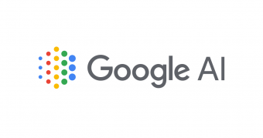
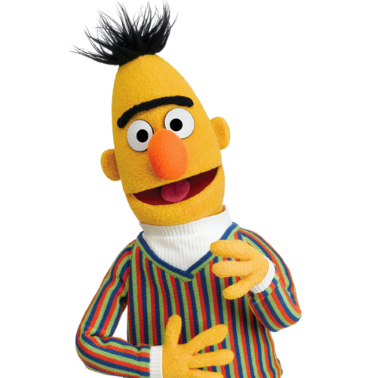
BERT
Bidirectional Encoder Representations from Transformers (BERT)⁽¹⁾, from another Google team in 2018.
BERT is large! With 340 million parameters, 12 or 24 Transformer blocks and 12 or 16 attention heads (BERTbase and BERTlarge respectively).
Trained on 3.3 Billion words – GoogleBooks and Wikipedia.
BERT introduced the idea of the masked language model, which allows for bidirectional Transformer models.
Devlin, J. et al. (2018) ‘BERT: Pre-training of Deep Bidirectional Transformers for Language Understanding’, arXiv. Available at: https://github.com/tensorflow/tensor2tensor
Notes:
Cannot generate language!
Throw away the ‘Decoder’.

Slide 74
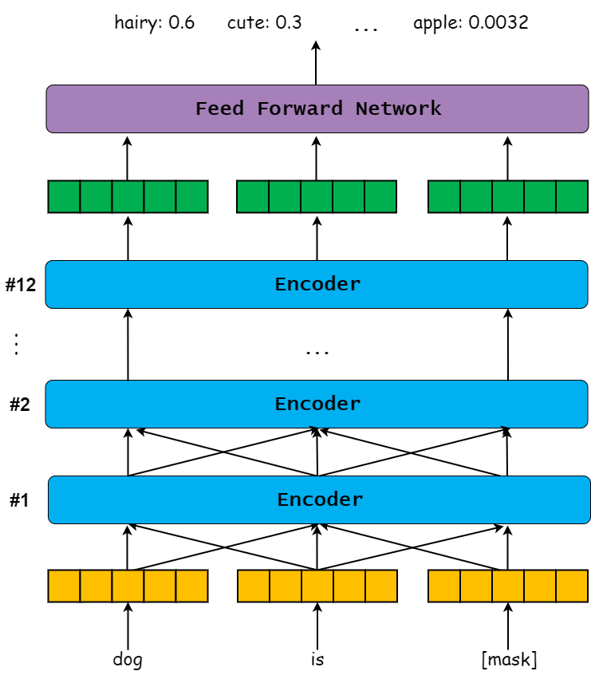
BERT - Masked Language Models
A masked language model that randomly selects input words with a probability of 15%. Then predict the missing word.
80% of the time, replace the word with the [MASK] token:
my dog is hairy → my dog is [MASK]
10% of the time, replace the word with a random word:
my dog is hairy → my dog is apple
10% of the time, keep the word un-changed:
my dog is hairy → my dog is hairy
Devlin, J. et al. (2018) ‘BERT: Pre-training of Deep Bidirectional Transformers for Language Understanding’, arXiv. Available at: https://github.com/tensorflow/tensor2tensor
Notes:
Cannot generate language!
Throw away the ‘Decoder’.

Slide 75
BERT - Masked Language Models
BERT “does not know which words it will be asked to predict or which have been replaced by random words, so it is forced to keep a distributional contextual representation of every input token.”
In other words, it must have contextual knowledge about each word, not rely on finding patterns in the input.
The result? More state of the art on different 11 NLP tasks!
For SQuAD out performing humans by 2%
Task | Accuracy % (Increase )
Question Answering (SQuAD) | 93.2 (+1.5%)
Named Entity Recognition (CoNLL) | 92.8
GLUE (General Language Understanding Evaluation) | 80.4 (+7.6%)
MultiNLI | 86.7 (+5.6%)
Devlin, J. et al. (2018) ‘BERT: Pre-training of Deep Bidirectional Transformers for Language Understanding’, arXiv. Available at: https://github.com/tensorflow/tensor2tensor

Slide 76
Example from SQuAD
The Normans were the people who in the 10th and 11th centuries gave their name to Normandy, a region in France. They were descended from Norse ("Norman" comes from "Norseman") raiders and pirates from Denmark, Iceland and Norway who, under their leader Rollo, agreed to swear fealty to King Charles III of West Francia… etc…
Q: In what country is Normandy located?
A: France
Q: When were the Normans in Normandy?
A: 10th and 11th centuries.
Q: From which country did the Norse originate?
A: Denmark, Iceland and Norway.
https://rajpurkar.github.io/SQuAD-explorer/

Slide 77
Some Examples from GLUE
Winograd Reading comprehension:
I tried to keep the dogs out of the kitchen by putting a chair in the middle of the doorway, but it was too [wide/small].
Question: What was too [wide/small]?
Answers: The doorway/the chair.
Stanford Film Sentiment Analysis:
This is a film well worth seeing, talking and singing heads and all. - Positive
In a big corner office in Hell, Satan is throwing up his hands in surrender, is firing his R&D people, and has decided he will just screen The Master of Disguise 24/7. - Negative(?)
https://gluebenchmark.com/

Slide 78
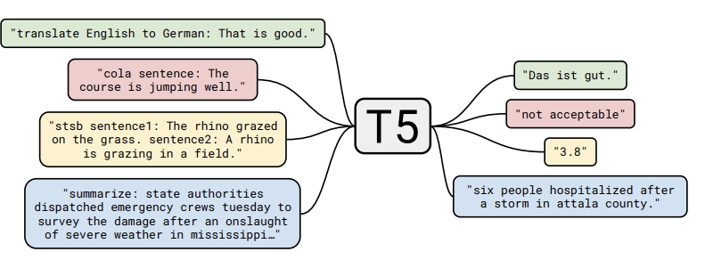
T5
The Text-to-Text Transformer (T5) considers each task (translation, classification, summarisation etc) is framed as a text generation problem.
To specify the task the model is to perform a task-specific prefix is added to the original input. For example: “translate English to French: ”
T5 is then trained in an unsupervised fashion, similar to BERT, where inputs are ‘corrupted’ and the model is tasked with recreating the input, or identifying the missing tokens.
Raffel, C., et. al (2019) Exploring the Limits of Transfer Learning with a Unified Text-to-Text Transformer.

Slide 79
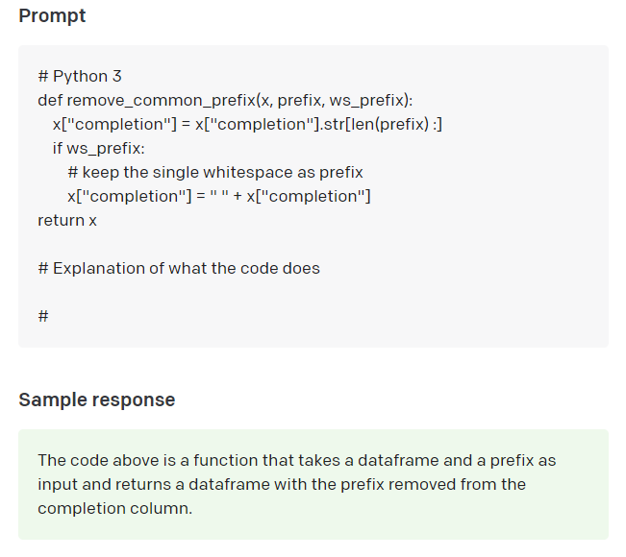
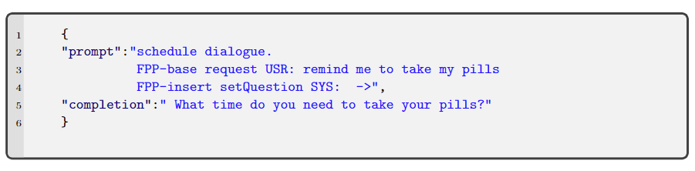
GPT-3
GPT-3 is trained on a more ‘traditional’ language modelling task, predict the next token given the previous sequence.
It was trained with 500B+ tokens and contains 175B parameters! But what makes GPT-3 novel (apart from its size) is it’s ability for ‘few shot learning’.
Similar to T5, GPT-3 accepts example prompts with appropriate outputs. Given just a few examples it is able to learn/adapt to new tasks that it has never seen before, making it much more flexible than other language models which require more data for fine tuning.
Brown, T.B., et al. (2020) Language Models are Few-shot Learners. In: Advances in Neural Information Processing Systems [online]. 2020
https://jalammar.github.io/how-gpt3-works-visualizations-animations/

Slide 80
GPT-4 (released this week)
Takes multimodal inputs
Can handle sequences of 20,000 words!
Which is why it can ‘predict’ an essay or code as a likely next input
So its all in the prompts …

Slide 81
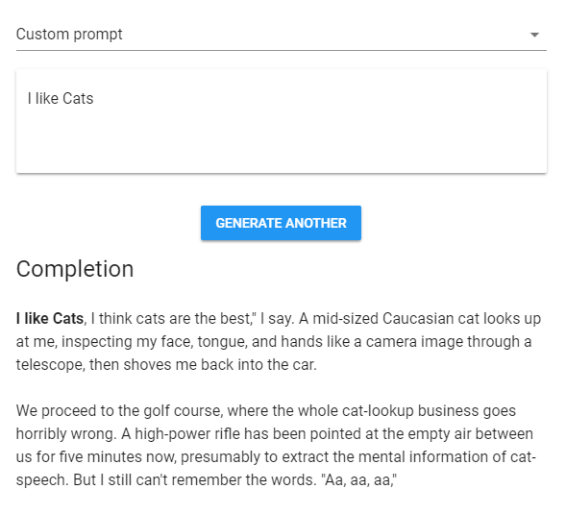
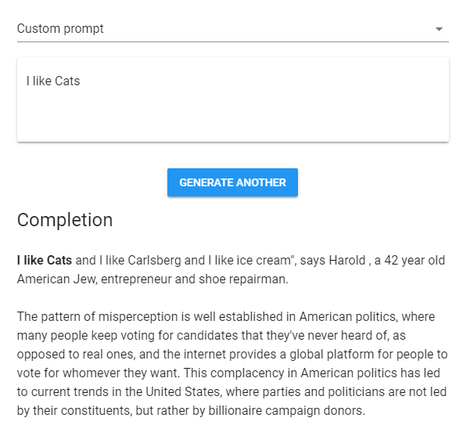
Talking to (GPT-2) Transformers…
https://transformer.huggingface.co/
https://talktotransformer.com/
Notes:
Write with a Transformer https://transformer.huggingface.co/
Talk to a Transformer https://talktotransformer.com/

Slide 82
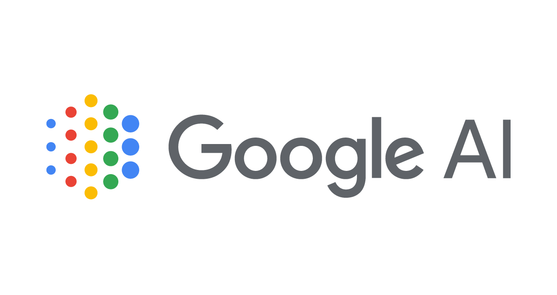

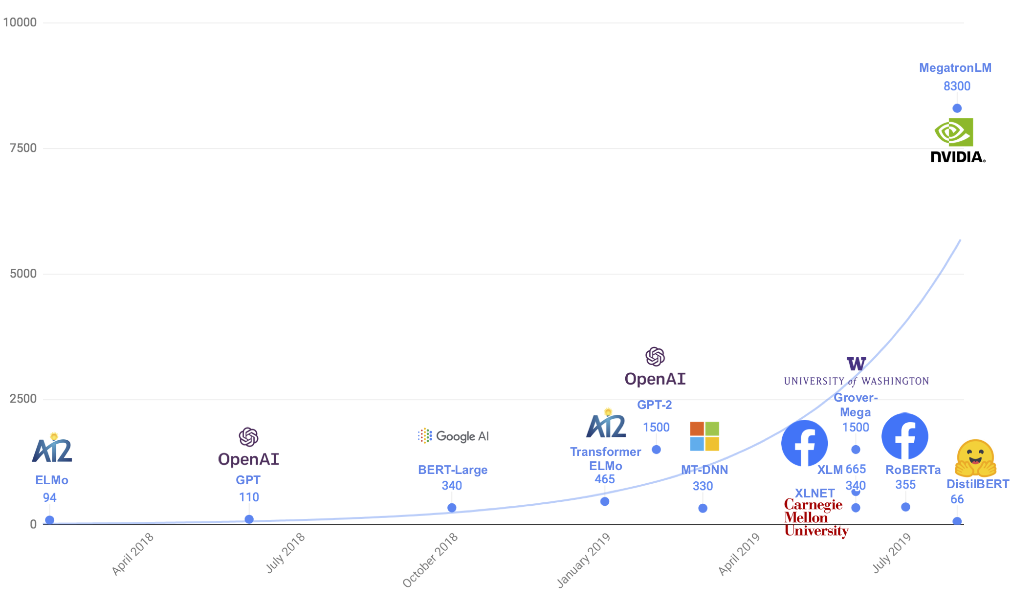
The Age of Big Transformers
Switch
~1.6 Trillion
GPT-3
~175 Billion
https://medium.com/huggingface/distilbert-8cf3380435b5
https://transformer.huggingface.co/
https://talktotransformer.com/
Notes:
Write with a Transformer https://transformer.huggingface.co/
Talk to a Transformer https://talktotransformer.com/

Slide 83
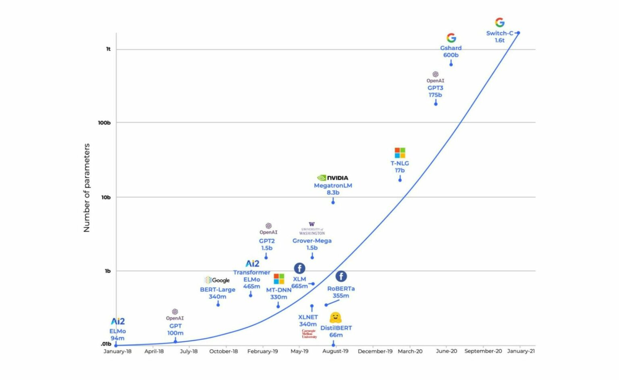
https://medium.com/huggingface/distilbert-8cf3380435b5
https://transformer.huggingface.co/
https://talktotransformer.com/
Notes:
Write with a Transformer https://transformer.huggingface.co/
Talk to a Transformer https://talktotransformer.com/

Slide 84
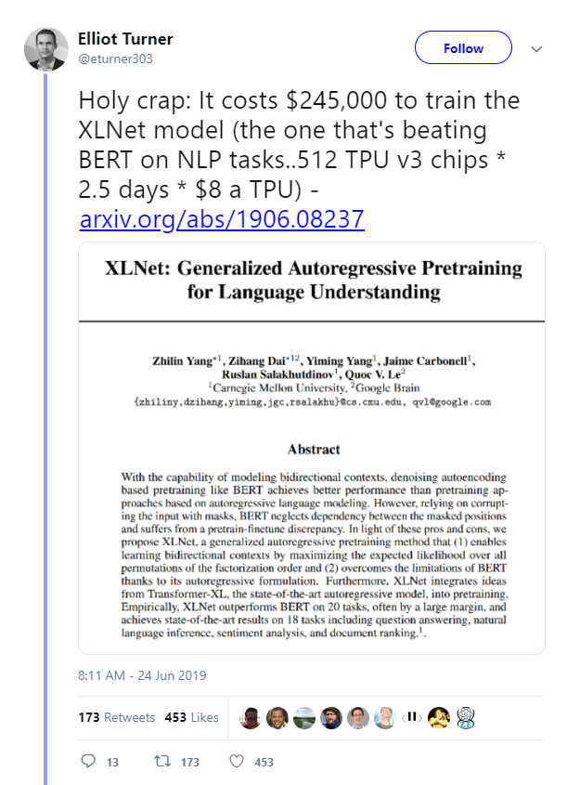
The Age of Big Transformers
Clever algorithms, transfer learning and big data have resulted in some impressive results.
They have certainly transformed(!) NLP research in recent years.
Bigger models + more data = better performance?
Sometimes, but improvements in algorithm design > parameter scaling.
Monetary and environmental cost. GPT-3 cost ~$4.6m dollars and took ~350 GPU years!
Big tech companies have an advantage - the resources.

Slide 85
For Next Week
Complete final exercise from practical and ensure you are familiar with various RNN configurations and how to implement them in Keras. Specifically:
The difference between taking the last hidden state as output, or the output at each timestep and performing dimensionality reduction.
Bi-directional and Deep RNN’s.
Record and present experimental results using Comet ML.

Slide 86
For Next Week
Complete final exercise from the practical and complete the various different sampling methods.
Optionally, you could modify the code to create a character-based language model, rather than word-based.
Notes:
Sentiment Analysis
Coreference Resolution (Anaphora)
Named Entity Recognition
Question Answering

